Slide 1

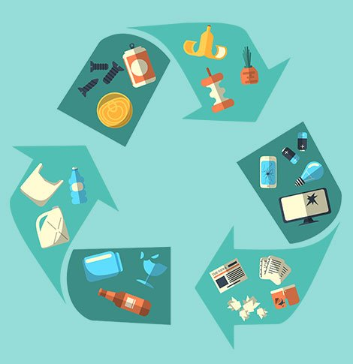
Know Your Waste
Subject: Environmental Studies
Grade: 11

Slide 2
LAND ACKNOWLEDGEMT
The campuses of Thompson Rivers University are located on the traditional and unceded territory of the Secwepemc Nation within Secwepemcul'ecw. As we share knowledge, teaching, learning and research within this university, we recognize that this territory has always been a place of teaching, learning and research. We respectfully acknowledge the Secwepemc—the peoples who have lived here for thousands of years, and who today are a Nation of 17 Bands. Take a moment to acknowledge the land you are currently in!

Slide 3
Identify…
Prepare a list of at least10-15 things that you have used today.

Slide 4
Sort…
Things that can be used again | Things that were disposed off

Slide 5

Stop, Think and Discuss…
Pick any 2 items from the list and share why you disposed off those items.

Slide 6
What do you understand by the term ‘Waste’?…
Share your understanding on the Jamboard.
Here is the link: https://jamboard.google.com/d/10M2boh7SR04oy8lyCHrzZ1mxIONLLggMoMXCEAutndA/viewer?f=0

Slide 7
5 Seconds Activity…
Look at the pictures and choose what do you think is the best from the given set of options.
Refuse
Reduce
Recycle
Reuse
4 Rs

Slide 8

Refuse
Reduce
Reuse
Recycle

Slide 9
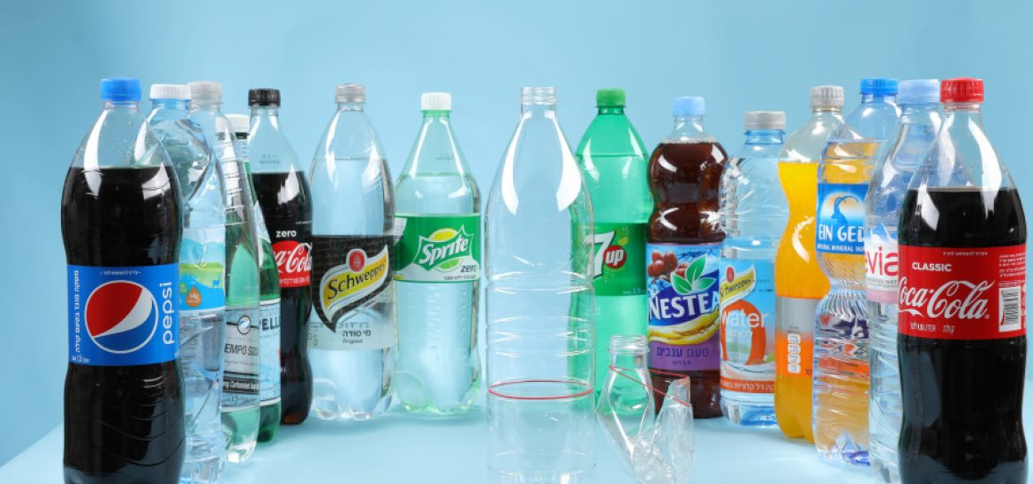
Refuse
Reduce
Reuse
Recycle

Slide 10
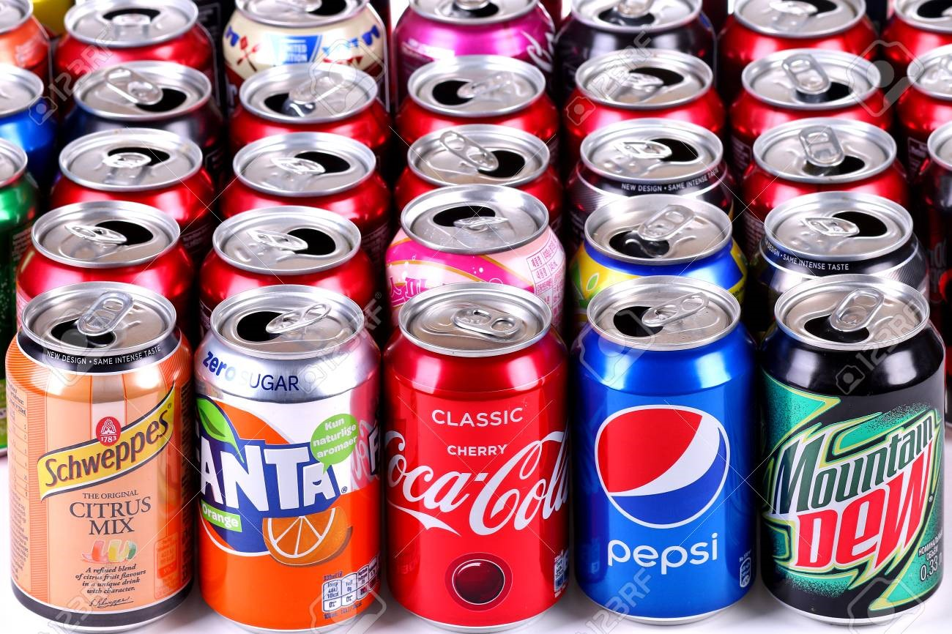
Refuse
Reduce
Reuse
Recycle

Slide 11

Refuse
Reduce
Reuse
Recycle

Slide 12

Refuse
Reduce
Reuse
Recycle

Slide 13
Let’s Discuss…
Refuse
Reduce
Reuse
Recycle

Slide 14
The Trash One Person Produces in a Year…
https://www.titlemax.com/discovery-center/lifestyle/trash-one-person-produces-year /

Slide 15
Exit Slip…
I can minimize or reduce the waste by…..
https://jamboard.google.com/d/1L1ALzjGdEsvCQjGRuXSsz-NsbFKmc1pCSFjCG4E-Ze0/viewer?f=0

Slide 16
Lesson Extension Activity…
Think of an everyday item that you can recycle. Demonstrate and discuss how have you recycled that item. For this, you can create a video or 5-minutes ‘Show and Tell’.

Slide 17


